Slide 1

CSC 102 Class projects
Adetoba Adebimpe

Slide 2
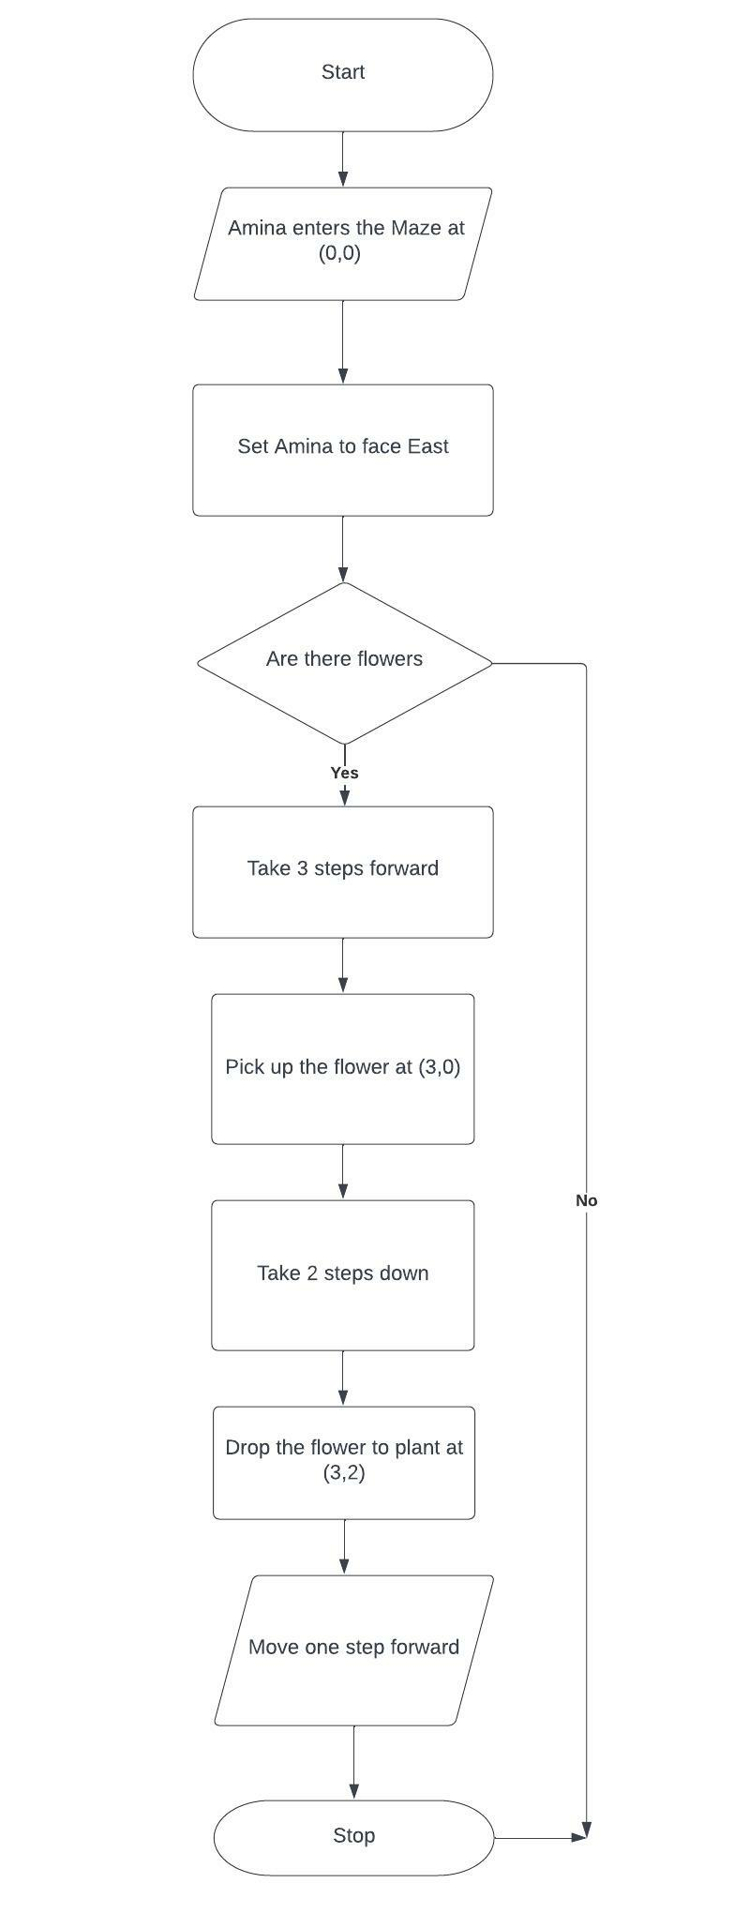
Project 1
Flowchart
Pseudocode
START
INPUT Amina on the island at (0,0)
SET Amina to face east
IF there are flowers
TAKE 3 steps forward
Pick up the flowers at (3,0)
MOVE 2 steps down
PLANT the flowers at (3,2)
OUTPUT one step forward
STOP

Slide 3
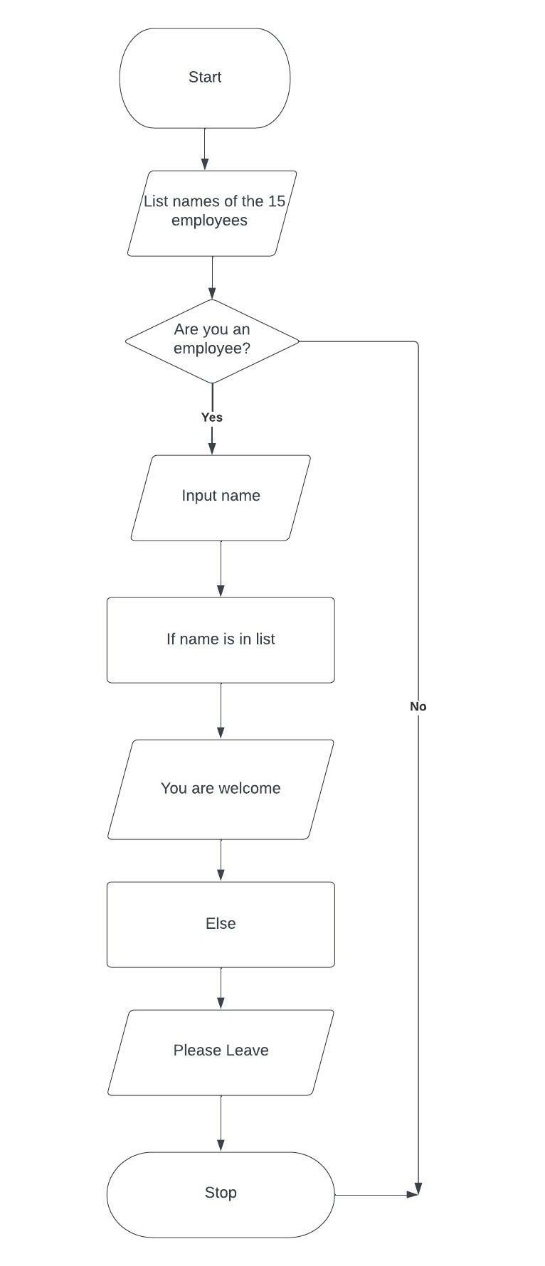
Project 2
Flowchart
Pseudocode
START INPUT list of names of the 15 employees
INPUT name
IF the name is in the list
PRINT You are welcome
ELSE
PRINT Please leave
STOP

Slide 4
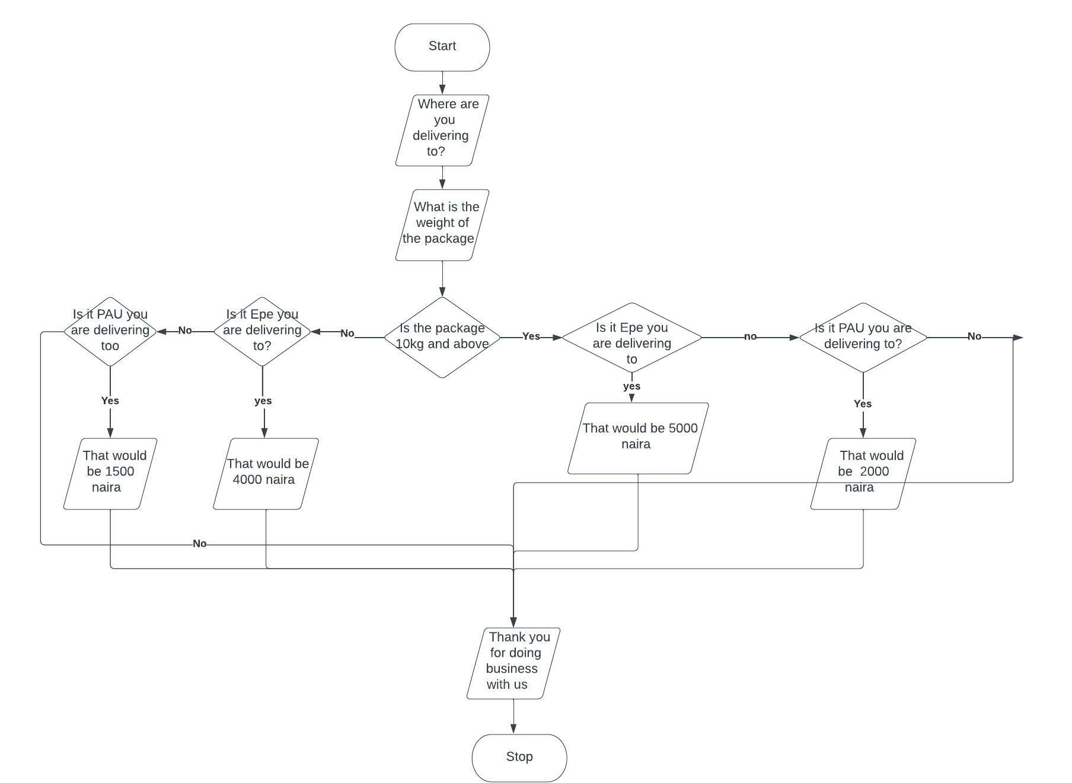
Project 3
Flowchart
Pseudocode
START
INPUT where are you delivering to?
INPUT what is the weight of the package?
IF the package is 10kg and above
PRINT Is it Epe you are delivering to?
IF yes
PRINT That would be 5000 naira
ELSE
PRINT Is it Pau you are delivering to?
IF yes
PRINT That would be 2000 naira
ELSE
PRINT We do not deliver there
IF the package is less than 10kg
PRINT Is it Epe you are delivering to?
IF yes
PRINT That would be 4000 naira
ELSE
PRINT Is it Pau you are delivering to?
IF yes
PRINT That would be 1500 naira
ELSE
PRINT We do not deliver there

Slide 5
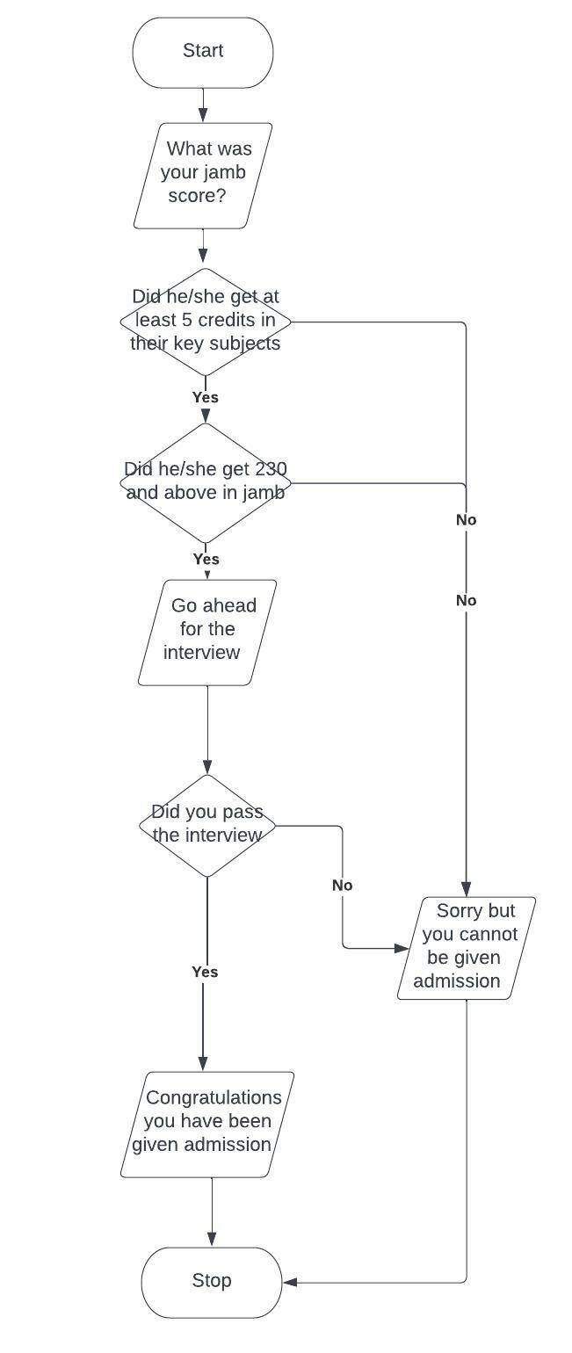
Project 4
Flowchart
Pseudocode
START
INPUT your jamb score
IF he/she got at least 5 credits in their key subjects and 230 and above in jamb
PRINT go-ahead for the interview
ELSE
PRINT sorry you cannot be given admission
IF he/she passed the interview
PRINT Congratulations you have been given admission
ELSE
PRINT sorry you cannot be given admission
STOP

Slide 6
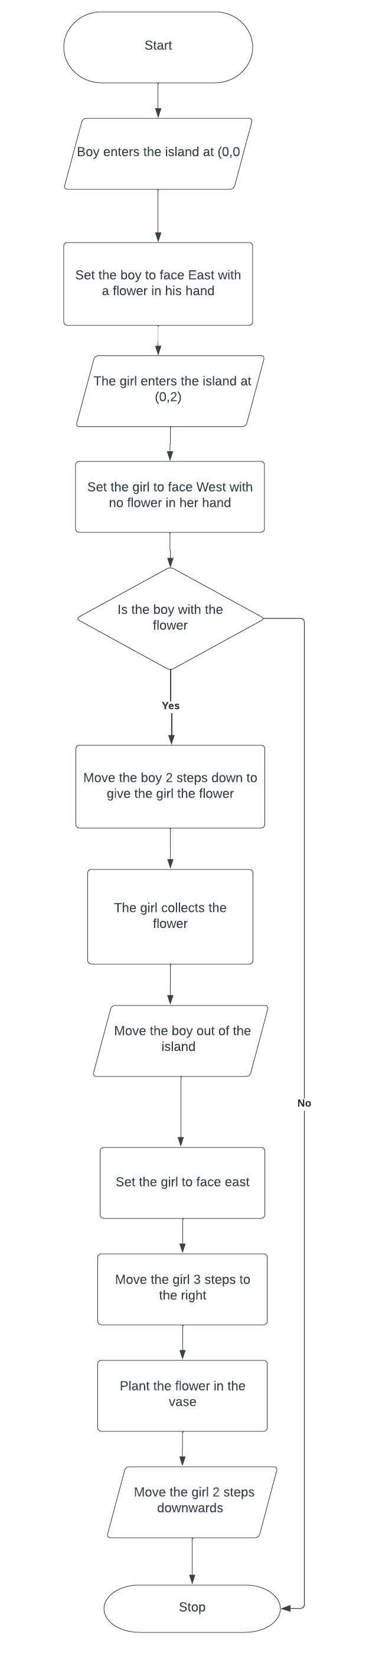
Project 5
Flowchart
Pseudocode
START
INPUT the boy into the island and set him to face East with a flower in his hand
INPUT the girl into the island and set her to face west without a flower in her hand
IF the boy is with a flower in his hand
MOVE him 2 steps down to give the flower to the girl
MOVE the boy out of the island
SET the girl to face east
MOVE the girl 2 steps to the right
PLANT the flower in the vase
MOVE the girl 2 steps downwards
ELSE
STOP

